Slide 1
Comprehensive VHDL Hamdi Abdelbagi Phone: (937) 830-7761 Email: abdelbagih1@udayton.edu

Slide 2
Memories
Aim
To learn further useful feature of VHDL for modelling and synthesizing memories
Topics covered
Array types
Modelling memories
IP Generators
Using generated components
Implementing ROMs

Slide 3

Array Types
Declare one kilobyte memory
Constrained array type

Slide 4


Writing to array type objects
Write a value to a single memory location
Fill the entire memory with the same value
Aggregate
Aggregate
Nested aggregate

Slide 5
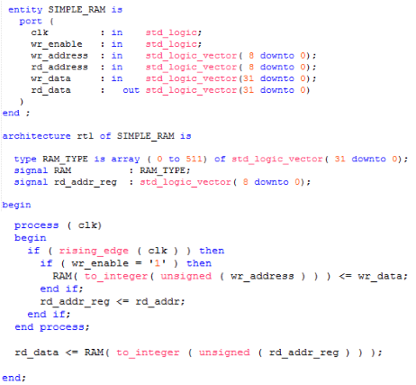
Modelling Memories

Slide 6
Block Memory
Modern FPGA devices contain block memories
Support from ROM, RAM and CAM
Programmable address/data widths
Single/dual port access
Registered inputs and outputs
Pipeline registers for faster throughput
Synthesis tools infer simple configurations
e.g. single port
Instantiation is necessary for more complex memories
Dual port, FIFO or data width conversion
Vendor IP generator tools create templates and simulation models

Slide 7
IP Generators

Slide 8
Black Boxes

Slide 9
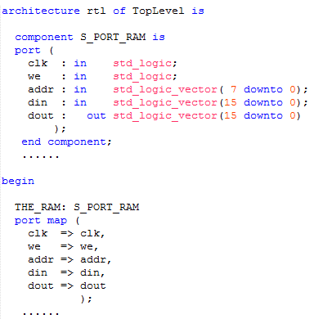
Using A Generated Component

Slide 10
Implementing ROM
ROM can be used for
Encoders and decoders
Constant coefficient multipliers
….
Either configure lookup tables or built-in RAMs as ROM
Similar to using RAM
Or implement ROM function as logic
May be smaller, but slower

Slide 11
VHDL ROM Example

Slide 12
Memory Initialization
Both ROMs and RAMs may be initialized on FPGAs
ASICs only ROMs
Requires initialization data to be loaded
During simulation (from a file, or using a constant)
During implementation (from a file by place and route)
RAM and ROM data can be loaded into FPGAs when the bitstream is downloaded
Normally device reset does not affect (initialize) RAMs

